Slide 1
Angiosperms & Plant Nutrition
Campbell 38-39

Slide 2
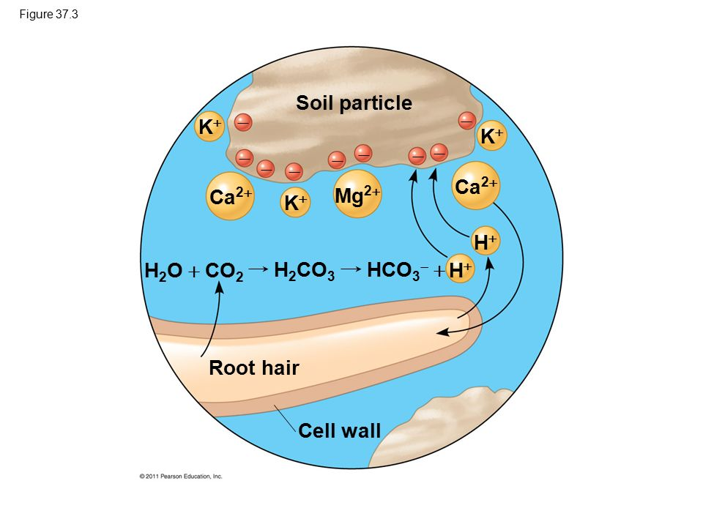
Soil
Topsoil - composed of living organisms, minerals, dead organisms, and organic matter
Most fertile soil is called loams - equal amounts of sand, silt clay; porous
Inorganic - surface charges from ions
Cations (K⁺ Ca²⁺ Mg²⁺) adhere to negatively charged soil
Roots absorb mineral cations from the soil solution. cation displacement (often with H⁺)
Capacity to exchange is determined by the Number of cation adhesion sites and pH
Anions (NO₃⁻ H₂PO₄⁻ SO₄²⁻) are easily released
Organic
Humus is the organic material from decomposition, feces, and other matter from bacteria or fungi
Allows soil to be crumbly and porous
Many living organisms - bacteria, fungi, protists, etc
All impact the soil
Notes:
Anions listed : nitrate phosphate sulfate
Water + Co2 → Carbonic acid → Bicarbonate

Slide 3
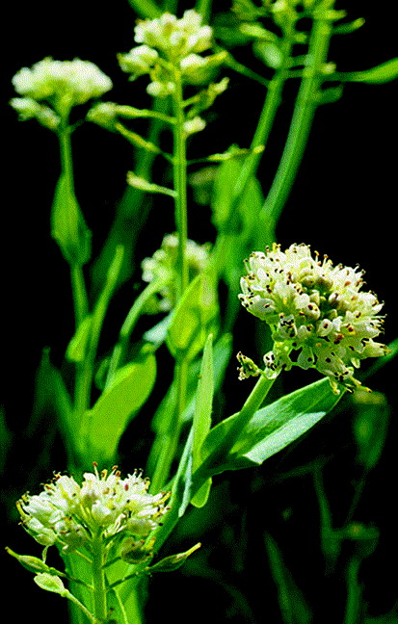
Conservation
Irrigation
Irrigation from underwater reserves leads to land subsidence
Can also lead to soil salinization
Fertilization
Organic fertilizers release minerals gradually
Inorganic are more immediate and are often not retained by the plant
Adjusting pH
pH controls how well plants can absorb nutrients
Most prefer slightly acidic for H⁺ concentration
Different acidity may make certain minerals more available
Erosion
Water and wind can remove topsoil; nutrients carried away
Phytoremediation
Biotechnology that harnesses plants to extract pollutants and concentrate them in plants (Thlaspi caerulescens)
Notes:
Subsidence - sinking Salinization - over salting Thlaspi caerulescens - alpine pennycress

Slide 4
Macronutrients and Micronutrients
Certain elements are essential for plant life cycle
Researchers use a hydroponic culture (mineral solutions)
Nine of essential elements are macronutrients
Plants require large amounts
Carbon, oxygen, hydrogen, nitrogen, phosphorus, sulfur (structure)
Potassium, calcium, magnesium
Nitrogen is most impactful on growth (proteins, nucleic acids, chlorophyll etc)
Eight are micronutrients
Small amounts required
Chlorine, iron, manganese, boron, zinc, copper, nickel, molybdenum
Sometimes sodium in C4 or CAM photosynthesis
Cofactors (Often catalytic which is why plants do not require much)

Slide 5
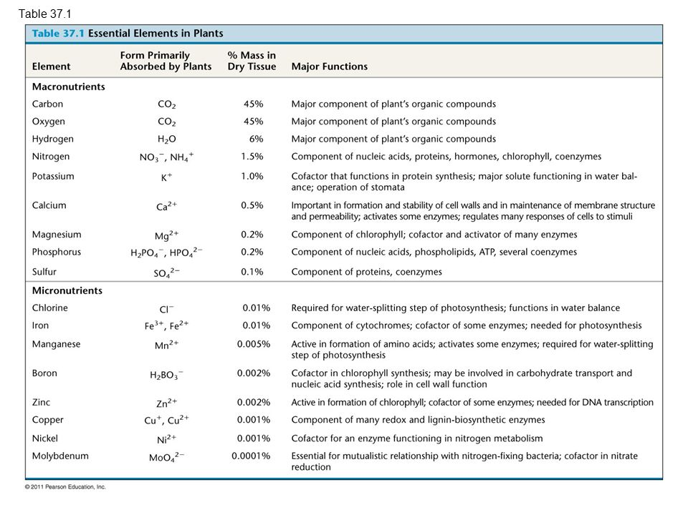
Notes:
Some notes on deficiency in the textbook

Slide 6
Soil Bacteria
Rhizobacteria in the Rhizosphere around plant roots absorb secretions from plant roots including sugars, amino acids, and organic acids
Also enhance plant growth through chemicals or reducing toxins
Increase yield and decreases need for fertilizer
Nitrogen cycle - majority of nitrogen from soil bacteria
Ammonifying bacteria by breaking down organic compounds
Nitrogen fixing bacteria convert N₂ to NH₃ which combines with an H⁺ to form ammonium
NO₃⁻ is formed through nitrification by nitrifying bacteria
Denitrifying bacteria returns it to atmosphere as gas

Slide 7
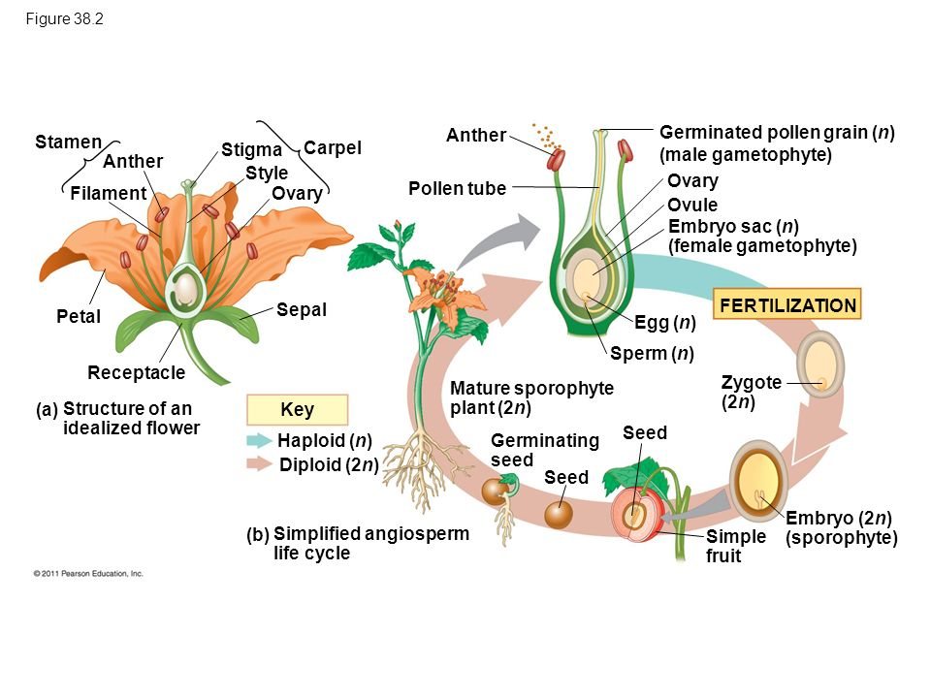
Angiosperms
Spore (haploid) and Sporophyte (diploid)
Sporophyte (meiosis) → Spores (mitosis) → Gametophyte (fusion) → diploid zygote
Sporophyte is the dominant longer lived generation
Smallest gametophytes
Flowers - reproductive shoots
Cease growing once the flower and fruit form
Sepals, petals, stamens and carpels are attached to the receptacle
Stamens and carpels are reproductive
Stamen consists of filament stalk and anther which contains pollen sacs
Carpel has an ovary at the base and a style
Stigma (sticky) at top captures pollen
Number of ovules species dependent
Pistil refers to a single or fused carpels
Complete vs incomplete
Incomplete flowers lack some of the organs
Some are sterile or unisexual

Slide 8
Male and Female Gametophytes
Male
Each anther contains four microsporangia or pollen sacs
Each microsporangia contains many diploid microsporocytes
Each microsporocyte goes under meiosis forming four haploid microspores
Each microspore goes under mitosis to produce a male gametophyte with a generative cell and a tube cell
Spore wall + two cells = pollen grain
Spore wall is made from microspore and the anther
The generative cell passes into the tube cell in the gametophyte
Once it reaches a stigma, it creates a pollen tube that sends sperm to the female gametocyte
Male gametophyte divides and forms two sperm cells
Pollen tube goes through style and into the ovary

Slide 9
Male and Female Gametophytes
Female
15 variations in the development
Most common:
Begins in the megasporangium of each ovule
Two integuments (layers of protective sporophytic tissue that develops into the seed coat) form each megasporangium leaving and opening called the micropyle
One cell in the megasporangium of each ovule enlarges and undergoes meiosis, producing four haploid megaspores
One survives, rest degenerate
Survivor divides by mitosis without cytokinesis resulting in one large cell with eight haploid nuclei
The multinucleate mass is partitioned by membranes into a multicellular female gametophyte (embryo sac)
Cell fate is determined by a gradient of auxin originating from the micropyle
At the micropylar end, two synergid cells surround the egg and guide the pollen tube with chemical attractants
The other two nuclei (polar nuclei) are not partitioned but share the cytoplasm of the large central cell
The ovule which becomes a seed contains the embryo sac and two surrounding integuments

Slide 10
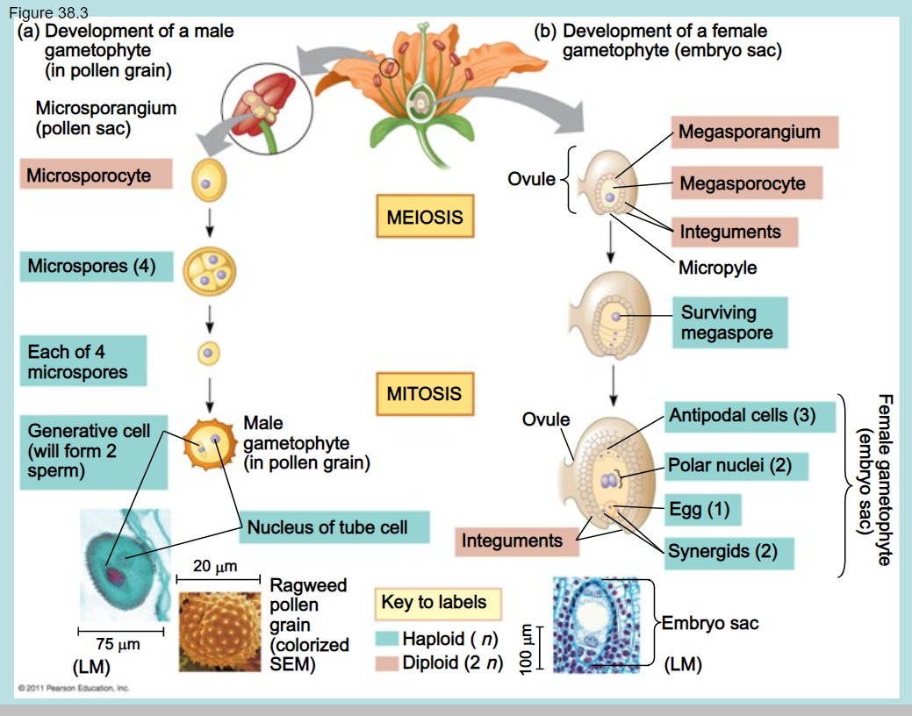

Slide 11
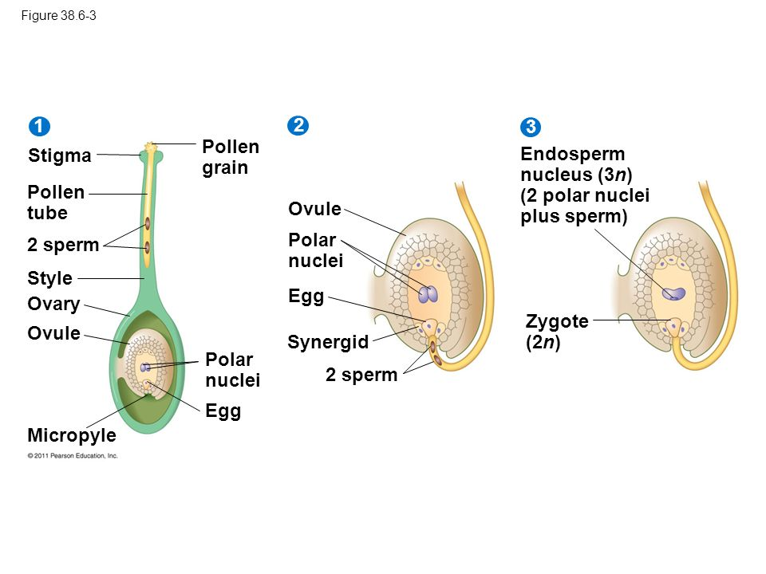
Pollination
Transfer of pollen from an anther to a stigma
Wind, water, or animals
Enormous amounts to compensate for randomness
Double fertilization
The generative cell formed two sperm
One sperm combines with the egg
One with the two polar nuclei forming a triploid nucleus, creating the endosperm
Stores food in the seed
Ensures the endosperm only develops in ovules with a fertilized egg to minimize waste

Slide 12
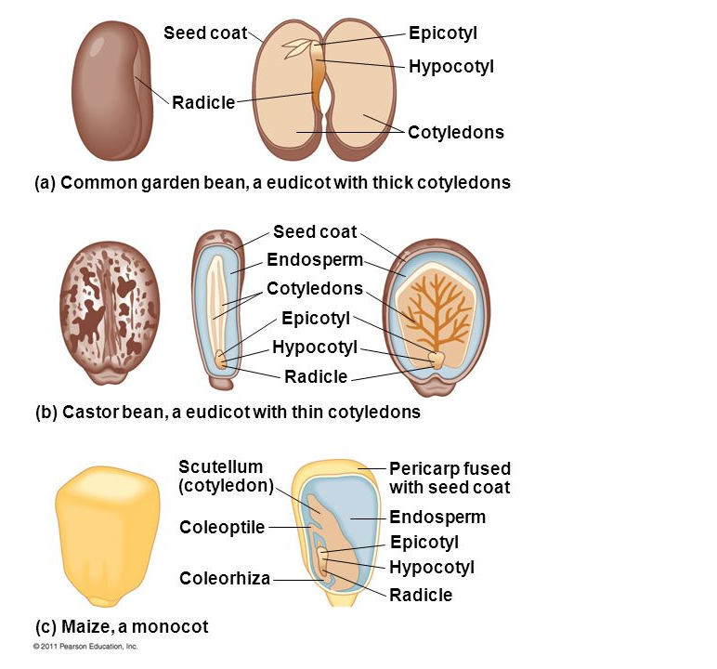
Development
After double fertilization, the ovule develops into a seed and stockpiles proteins oils and starch while the ovule develops into a fruit around the seed
Endosperm development
Develops before embryo
The triploid nucleus divides forming a liquid multinucleate cell
Becomes partitioned by forming membranes between the nuclei
Produces cell walls and becomes solid
Embryo development
Basal and terminal cell
Terminal turns into most of the embryo
Basal forms the suspensor which delivers nutrients
Cotyledons form - store food and help with germination
Monocot:1 Eudicot:2
Eudicot: below where the Cotyledons is the hypocotyl (above radicle), above is epicotyl
Monocot: Coleoptile covers the young shoot (epicotyl), Coleorhiza covers the young root (radicle)
Notes:
IMPORTANT CUT CONTENT - seed dormancy, seed germination and seedling development, fruit

Slide 13
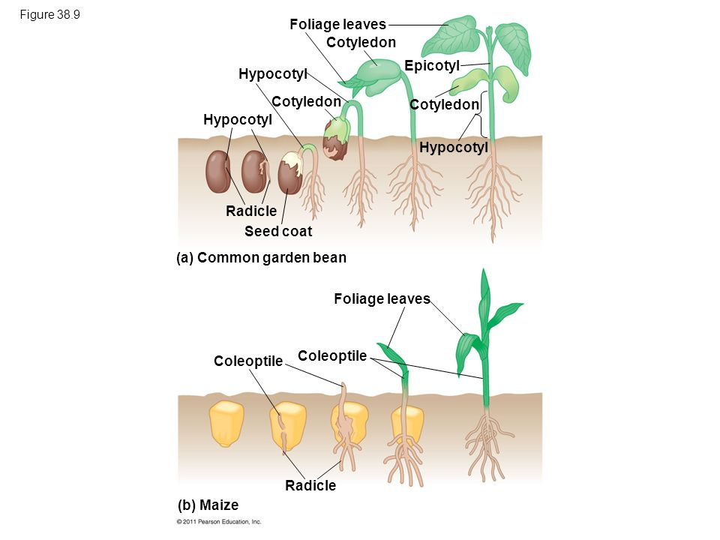
Seeds Germination
Seed Dormancy
Seeds can remain dormant until favorable environmental cues awaken them
Seed Germination
Depends on imbibition - the uptake of water
Imbibing a seed causes it to rupture its coat and begin growth.
First the radicle then embryonic root emerge, then the shoot breaks through the surface
In eudicots a hook forms in the hypocotyl and growth pushes the cotyledon above ground
Monocots break the ground using the coleoptile
Notes:
IMPORTANT CUT CONTENT - seed dormancy, seed germination and seedling development, fruit

Slide 14
Vegetative (Asexual) Reproduction
Some plants (dandelions) undergo apomixis, producing seeds without needing pollination or fertilization
Asexual is beneficial if other organisms are sparse
But no gene variation
Mechanisms to prevent
Dioecious species
Staminate (lacking carpels) or carpellate (lacken stamens)
Stamens and carpels may be mature at different times
Self-incompatibility
If too similar to own pollen, rejected

